Slide 1
8-Puzzle using BFS, DFS, Dijkstra algorithms
Uliana Ozerova, Amir Aslamov

Slide 2
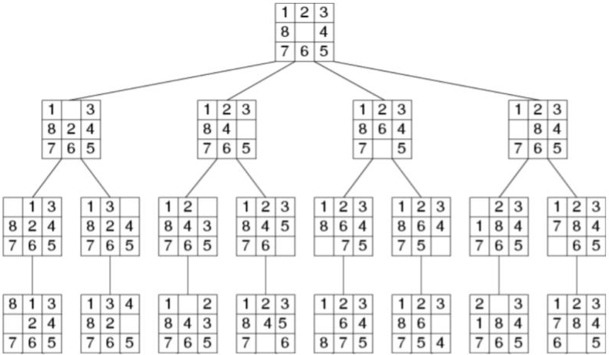
8-PUZZLE INTRODUCTION —> A graph DS
The idea is to find a goal state.
Each child stores a puzzle created by sliding any of the neighbors into the empty space.
Up to 4 children.
CHALLENGE: not knowing what the graph will look like ahead of time.
Only need to expand the node we want to explore.

Slide 3
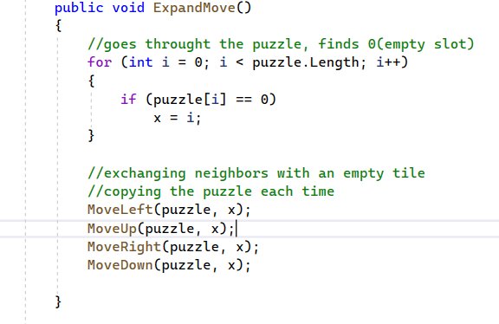
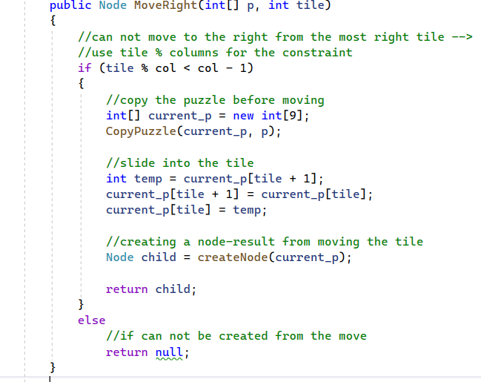
HOW WE FOUND NEIGHBORS
~ iterate through the puzzle array
~ find an empty slot
~ create a copy of the puzzle
~ exchange the empty slot with the neighbor, store in the copy
~ create a node out of the new array, making the original puzzle a parent.

Slide 4
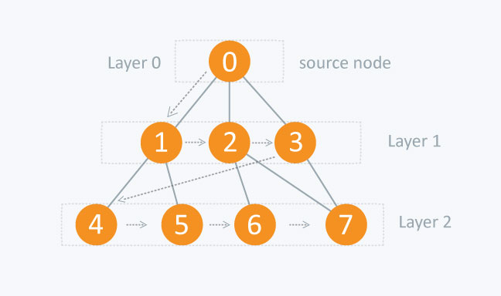
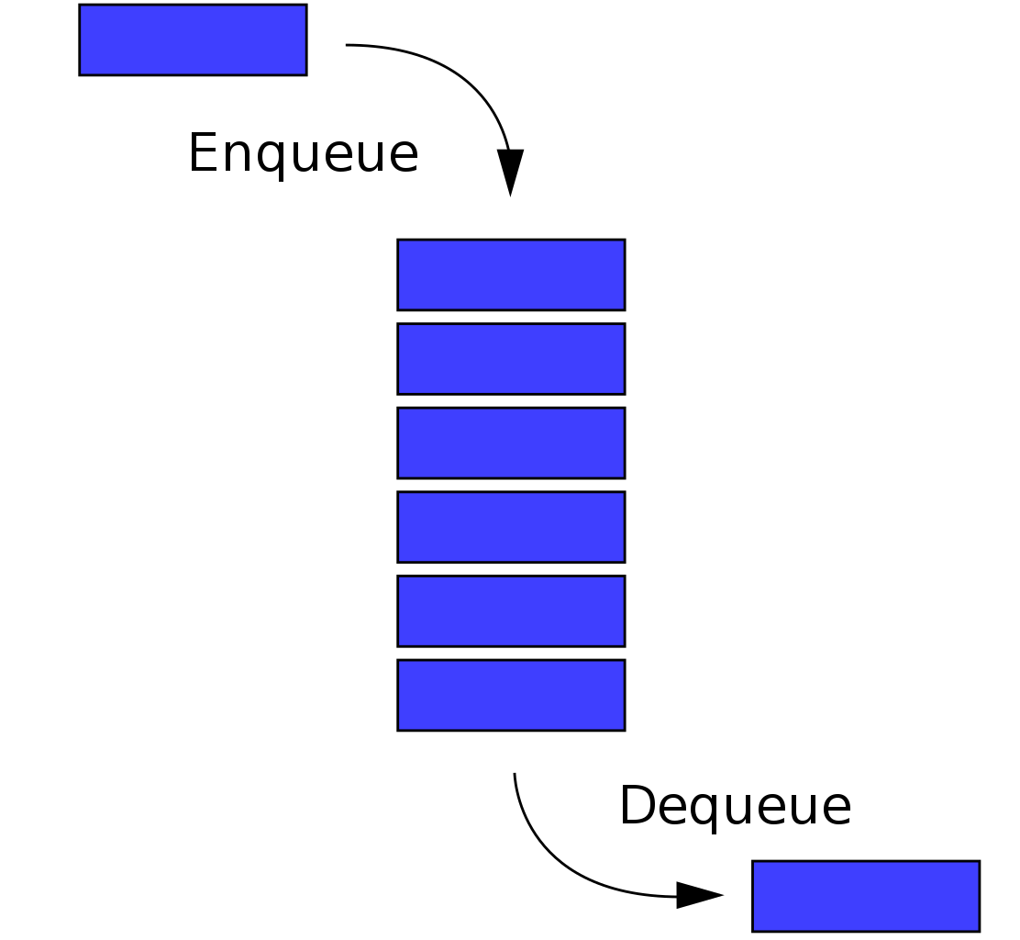
BFS
BFS is a graph-traversing algorithm that visits all adjacent vertices - neighbors - of a vertex before moving to the next one
The running time of this algorithm is O(V + E) because it visits every edge and node at least once.
In order to keep track of the nodes to be explored in sequence, we used a Queue data structure and enqueued adjacent nodes of a visited node to the queue for immediate exploration
Queue was implemented because in BFS traversal we traverse all immediate children(adjacent nodes) of a node first, before proceeding to the adjacent nodes of the nodes visited

Slide 5
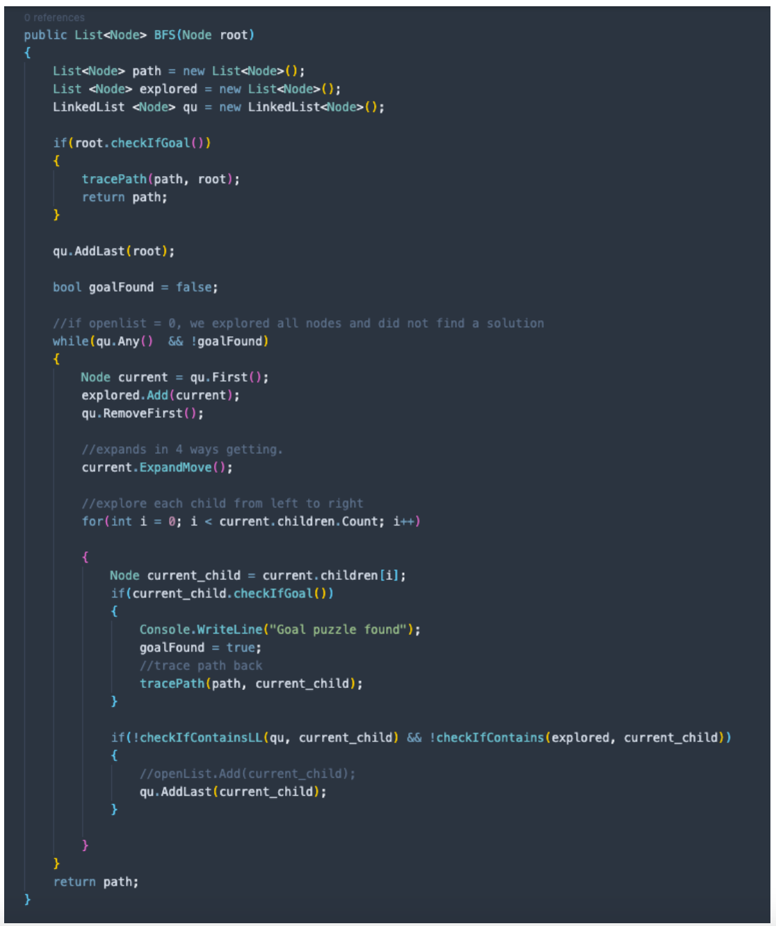
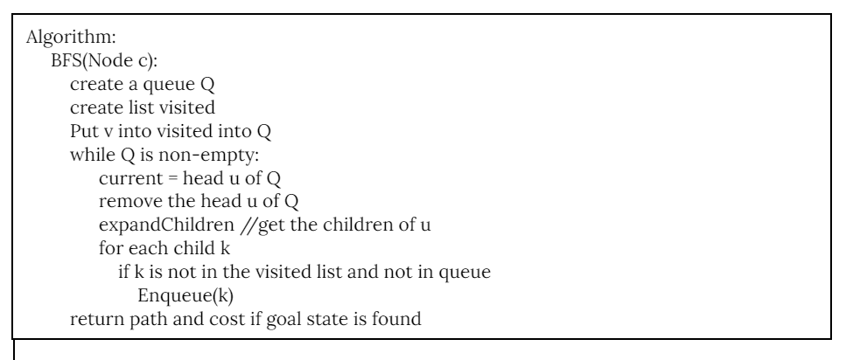
BFS Pseudocode/Implementation

Slide 6
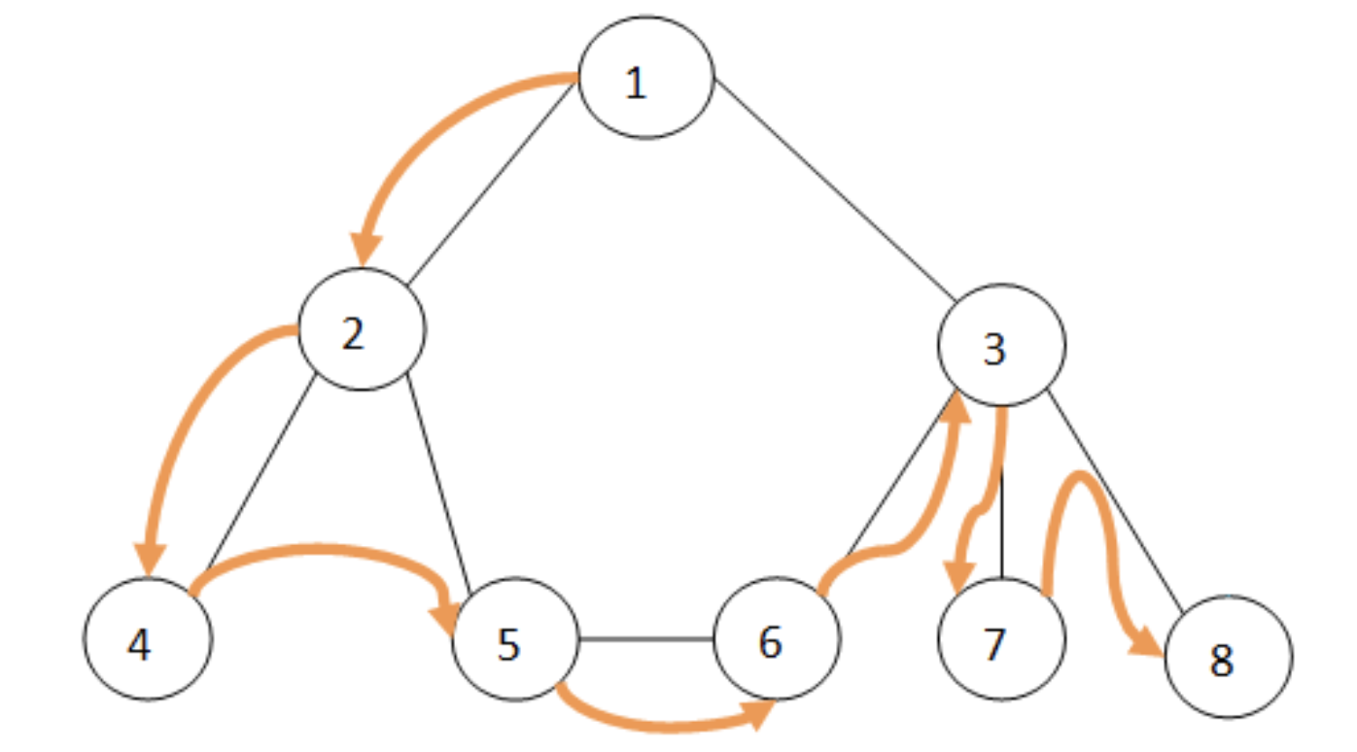
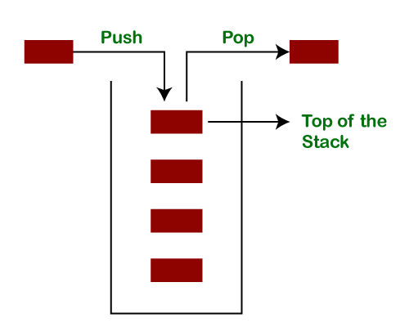
DFS
DFS is a graph-traversing algorithm that starts from the starting vertex and continues to explore vertices as far as it can before backtracking
The running time of this algorithm is O(V) as it visits every vertex at least once.
DFS is applicable to the Tree data structure and in the problem of 8 Puzzle, we have implemented the nodes in a Tree data structure with children nodes as possible ways to move the empty tile on the board
In order to keep track of the nodes to be explored in sequence we used a Stack data structure and pushed the nodes visited to the stack to be explored in backtracking
Stack was implemented because in DFS traversal we keep traversing down the children of a node before exploring the parents, so the first node visited gets explored the last.

Slide 7
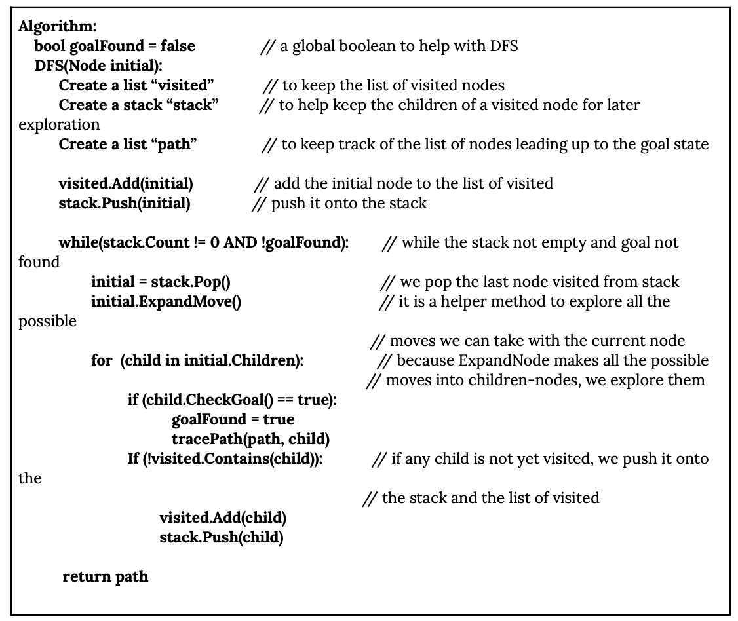
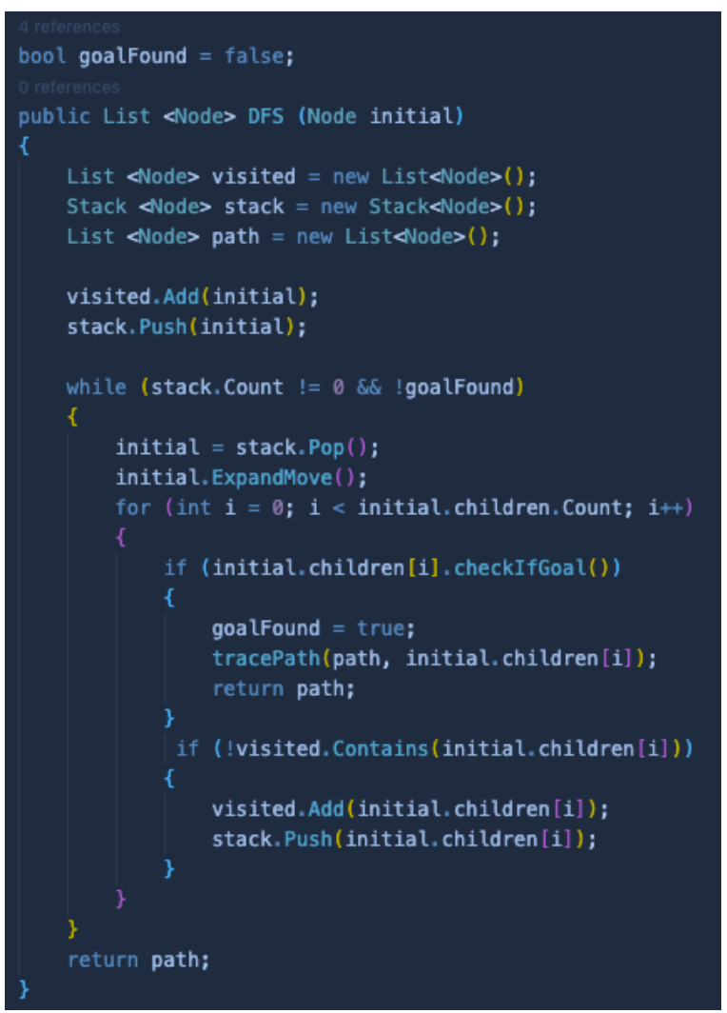
DFS Pseudocode/Implementation

Slide 8
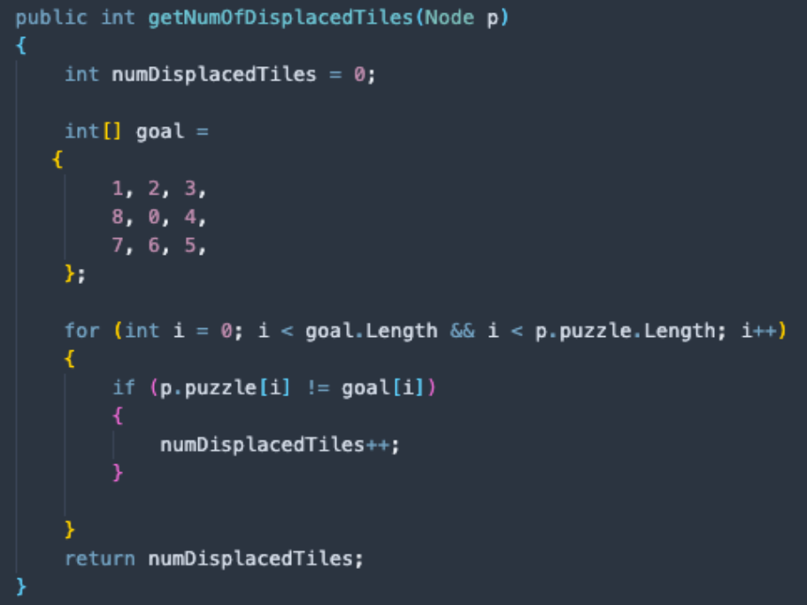
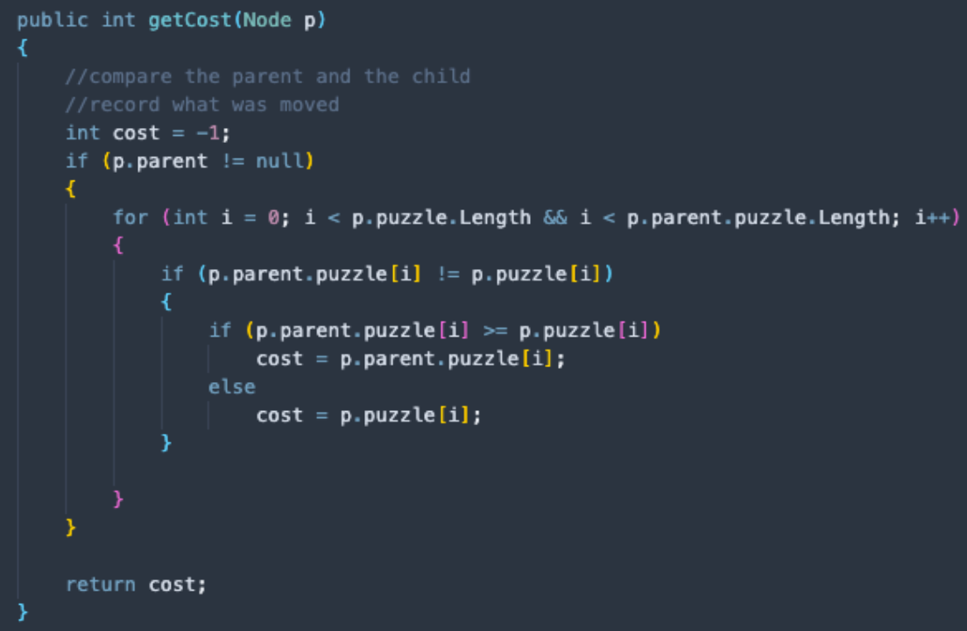
CALCULATING COST FOR DIJKSTRA
To help with the implementation of Dijkstra’s algorithm, we created helper functions to calculate the cost of each node and the number of displaced tiles in a node
The function “getCost” would scan all the tiles of a node and its parent to track what tiles have been moved. It helps in calculating the cost of moving a tile, which is equal to the number of the moved tile plus the number of displaced tiles
The function “getNumOfDisplacedTiles” would compare each tile of the node to each tile of the goal node and return the number of tiles not in place

Slide 9
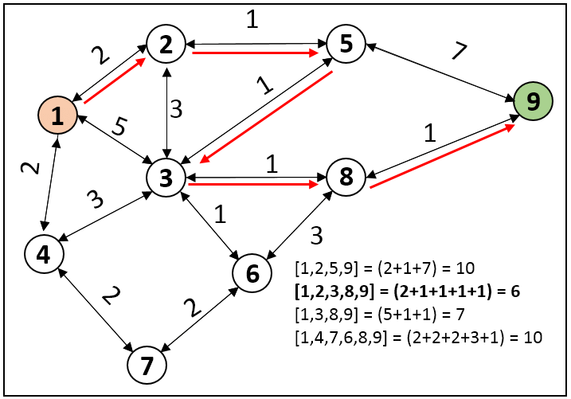
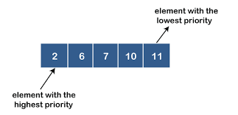
DIJKSTRA ALGORITHM
Dijkstra’s algorithm is a greedy method of finding the shortest distance between any two nodes in a graph data structure
When applied to 8 Puzzle, this algorithm finds the goal node that can be reached with the least cost of displacement of tiles on the board
To implement the algorithm we used a Priority Queue data structure, which keeps the nodes sorted based on the costs associated with them, and at each exploration, we select the node with least cost
As the algorithm explored the nodes, it also calculates the appended cost of each node and stores them in the property of cost of each node

Slide 10
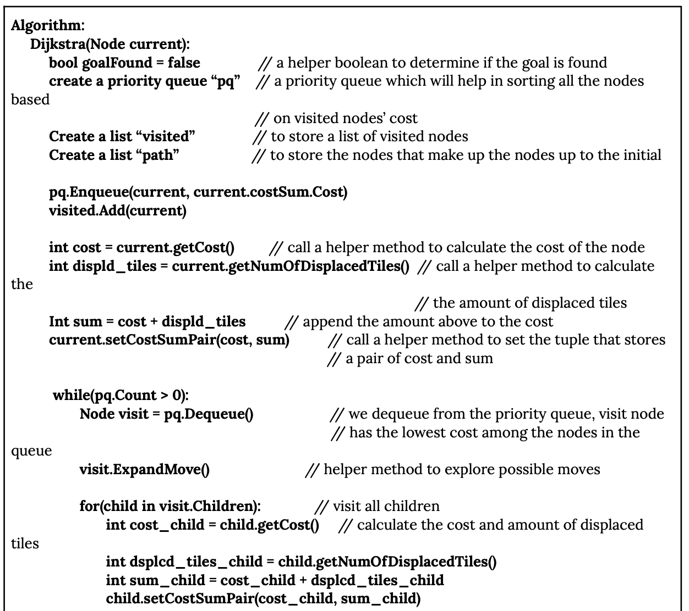
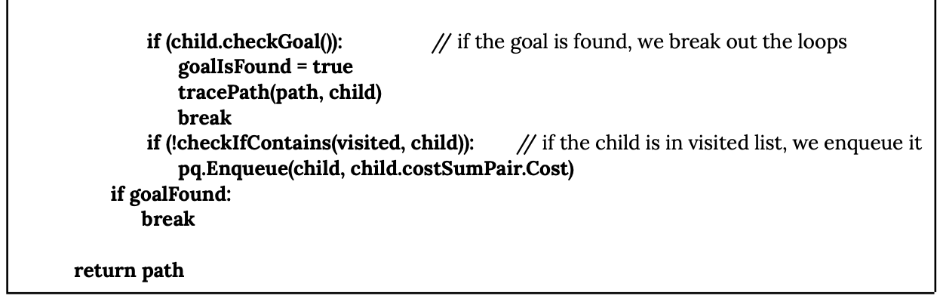
Dijkstra’s Algorithm Pseudocode

Slide 11
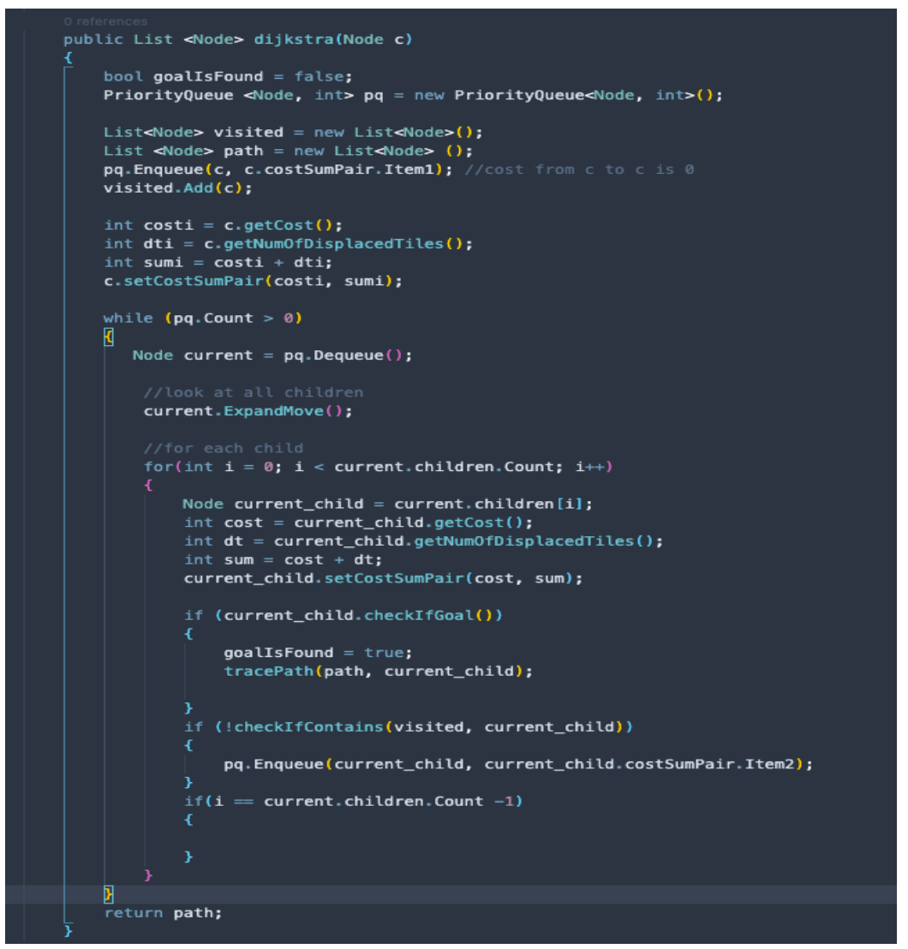
Dijkstra’s Algorithm Implementation
A custom priority queue data structure is used from C# library.
The helper function to calculate cost and number of displaced tiles in a node are central to the implementation of the algorithm

Slide 12
CONCLUSION
Not all puzzle is solvable.
Comparison of the execution times of each of the algorithms used to solve the 8 Puzzle problem indicates that BFS is the most efficient algorithm.
Because DFS traversal keeps expanding the node and the nodes can have many children, DFS proved to be the least efficient, because most of the time the goal node was not far from the initial node.
Because both DFS and Dijkstra’s algorithm use Queue data structure,
They both proved similar in execution, and had a roughly equal execution time

